Slide 1

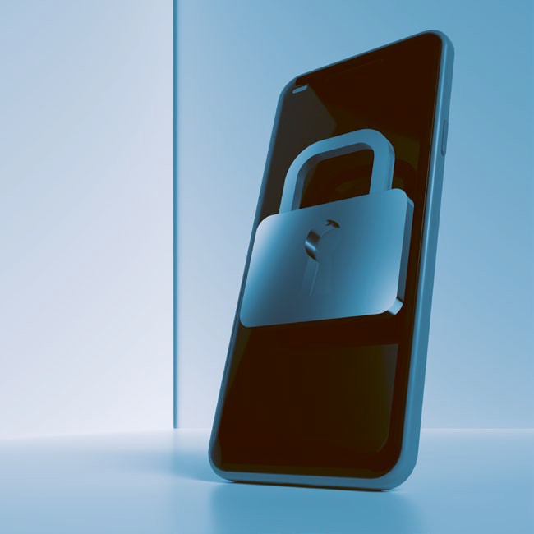
Prepare for Drones
Prevent Drone Observation
Drones always have cameras!
Turn your screen away from your window.
Lower shutters and adjust them at an upward angle.
Cover whiteboards and flipcharts after use.
Handle classified and proprietary documents with care, stow them away or cover them if not in use.
180˚
180˚
Screen Visibility
Line of Sight
Mitigate Blast Effects
Drones may carry explosives!
Arrange your workplace at a distance to windows. Blast decreases exponentially with distance, just a little space can make the difference.
Make yourself familiar with the drone assembly points. The drone is outside – stay inside.
Prepare against Cyber Attacks
Drones may fake your wireless network!
Clean your Wi-Fi List and delete all unsecured networks.
Configure your mobile device so you have to confirm each connection attempt.
Visit https://www.japcc.org/drone-drills to learn more about drone threats and how to prepare for them.
© JAPCC

Slide 2
Please visit
www.japcc.org/drone-drills
to download customizable templates for the annexes included in this paper, as well as additional educational references and materials.
Drone: © AdobeStock, 260694458 (10 November 2023)
Imagery Front Page
Drone Evacuation Point Sign – Drone: © AdobeStock, 260694458 (10 November 2023); Shield: © Copyrighted; Group: FourLeafLover – stock.adobe.com; Arrows: © Copyrighted Prevent Drone Observation (top/front view): © JAPCC; © Adobe (3D Objects)
Logo Headline – Shield: © Copyrighted; Drone Parts Next to Shield: © 1arts – stock.adobe.com Lock/Mobile Arrangement: © Adobe

